Slide 1
NGSI-LD IoT Agents
Jason Fox, Senior Technical Evangelist
FIWARE Foundation

Slide 2
Learning Goals
Review: What is an IoT Agent:
Why do you need them?
How do they work with NGSI?
NGSI-LD Measures
NGSI-LD Actuations + Lazy Attributes:
Registrations
Subscriptions
Provisioning NGSI-LD Devices:
Data Models and NGSI-LD @context
The role of metadata
GeoJSON and GPS device provisioning
Combining NGSI-v2 Devices with an NGSI-LD Context Broker

Slide 3
What is an IoT Agent?
IoT Agents overcome common problems in the IoT domain:
How can I translate my received measurements into a common standard
regardless of the device used?
How can I abstract my communications so the users are able to remain
unaware of the device specific protocols?
How can I map data received in a meaningful manner?
An IoT Agent translates an IoT specific protocol into NSGI (v2 or LD)
Any class of devices with an existing IoT Agent can be considered as FIWARE-Ready device
For unsupported protocols you can build your own agent.
You only need an IoT Agent if your devices can’t support NGSI interfaces directly

Slide 4
NGSI-LD - Why Linked Data?
My data is useful to me, but is more powerful shared with others
… but what about Conway's law?
Any organization that designs a system (defined broadly) will produce a design whose structure is a copy of the organization's communication structure.
— Melvin E. Conway
… how can I share data and benefit from other organizations if their organization “communicates” differently?

Slide 5
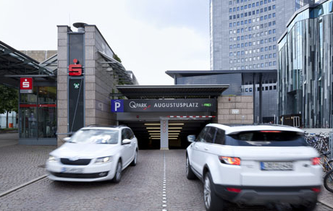

Illustrative NGSI-LD Use Cases
Car Parking
Cross-border Tourism
NGSI Linked Data use cases typically
involve context data exchange between
disparate organizations

Slide 6
Configuring an NGSI-LD IoT Agent
config.js
NGSI-LD @context
Environment Variables
IOTA_CB_NGSI_VERSION = "LD"
IOTA_TIMESTAMP = "true"
IOTA_FALLBACK_TENANT
equivalent to fiware-service
IOTA_FALLBACK_PATH
equivalent to fiware-service-path
IOTA_JSON_LD_CONTEXT
path to @context file (either a single file
or an array of files)
A linked data @context is mandatory for NGSI-LD,and should be made available publicly.
contextBroker: {
host: '192.168.1.1',
port: '1026',
ngsiVersion: 'ld',
jsonLdContext: 'http://context.json-ld',
fallbackTenant: 'openiot',
fallbackPath: '/',
}
{
"@context": [
"https://example.com/data-models/context.jsonld",
"https://uri.etsi.org/ngsi-ld/v1/ngsi-ld-core-context.jsonld"
]
}

Slide 7
NGSI-LD Core @context
"ngsi-ld": "https://uri.etsi.org/ngsi-ld/",
"geojson": "https://purl.org/geojson/vocab#",
"id": "@id",
"type": "@type",
"Date": "ngsi-ld:Date",
"DateTime": "ngsi-ld:DateTime",
"LineString": "geojson:LineString",
"Point": "geojson:Point",
"Polygon": "geojson:Polygon",
"GeoProperty": "ngsi-ld:GeoProperty",
"Property": "ngsi-ld:Property",
"Relationship": "ngsi-ld:Relationship",
"ContextSourceNotification":"ngsi-ld:ContextSourceNotification",
"ContextSourceRegistration":"ngsi-ld:ContextSourceRegistration",
"Notification": "ngsi-ld:Notification",
"Subscription": "ngsi-ld:Subscription",
… etc
"coordinates": {
"@container": "@list",
"@id": "geojson:coordinates"
},
"location": "ngsi-ld:location",
"observedAt": {
"@id": "ngsi-ld:observedAt",
"@type": "DateTime"
},
"unitCode": "ngsi-ld:unitCode",
"value": "ngsi-ld:hasValue",
… etc
"@vocab": "https://uri.etsi.org/ngsi-ld/default-context/"
Common NGSI-LD terms in the core @context for metadata - unitCode, observedAt
Common NGSI-LD terms for geoproperties - Point, LineString, location, coordinates, etc.
Device measures should always reuse the predefined terms

Slide 8
Implementation Specific @context
Reuse common data models and ontologies
Add use-case specific mappings where necessary
Remember to map all entities types, attributes and metadata attributes
Undefined terms will fallback to the default context https://uri.etsi.org/ngsi-ld/default-context
"fiware": "https://uri.fiware.org/ns/data-models#",
"schema": "https://schema.org/",
"example": "https://example.com/datamodels.html/",
"Building": "fiware:Building",
"Device": "fiware:Device",
"FillingLevelSensor": "example:FillingLevelSensor",
"SoilSensor": "example:SoilSensor",
"TemperatureSensor": "example:TemperatureSensor",
"Tractor": "example:Tractor",
"Water": "example:Water",
… etc
"accuracy": "fiware:accuracy",
"batteryLevel": "fiware:batteryLevel",
"category": "fiware:category",
"controlledAsset": "fiware:controlledAsset",
"controlledProperty": "fiware:controlledProperty",
"deviceState": "fiware:deviceState",
"ipAddress": "fiware:ipAddress",
"macAddress": "fiware:macAddress",
"mcc": "fiware:mcc",
"osVersion": "fiware:osVersion",
"actuator": "https://w3id.org/saref#actuator",
"filling": "https://w3id.org/saref#fillingLevel",
"temperature": "https://w3id.org/saref#temperature",
"sensor": "https://w3id.org/saref#sensor",
"status": "https://saref.etsi.org/core/status",
"state": "https://saref.etsi.org/core/hasState",
"heartRate": "https://purl.bioontology.org/ontology/MESH/D006339",
… etc
"myCustomAttr": "example:mycustomAttr",
"secondCustomAttr": "example:2ndCustomAttr"

Slide 9
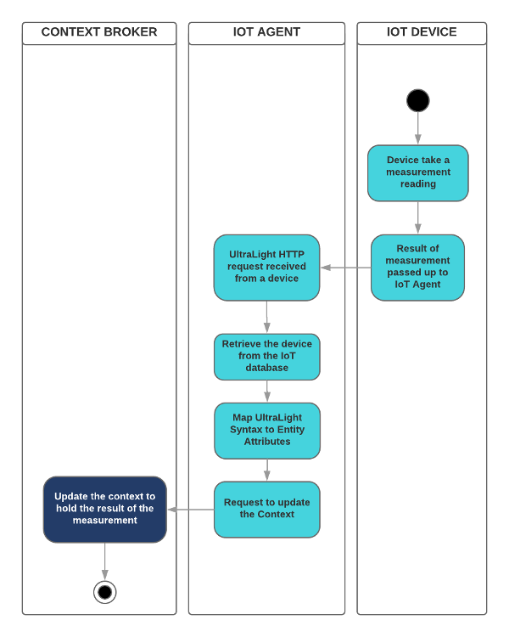
NGSI-LD Measures
The IoT Device is using a known payload syntax
Ultralight, JSON, SigFox, OPC-UA etc.
The IoT Device sends a reading using the agreed
protocol
HTTP, MQTT, AMPQ, LoRaWAN etc.
The IoT Agent interprets the payload and
transforms the measure into NGSI-LD
The only interface to the Context Broker is a
simple structured upsert of entities
potentially including linked entities

Slide 10
Measure: “Device X in Building Y has registered 25°C”
NGSI-LD Context Broker receives upsert
NGSI v2 Context Broker equivalent
curl -L -X POST 'http://localhost:1026/ngsi-ld/v1/entityOperations/upsert' \
-H 'Content-Type: application/ld+json' \
-d '[
{
"@context": "http://example.com/context.json-ld",
"id": "urn:ngsi-ld:Device:thermometer1",
"type": "Device"
"temperature": {
"type": "Property",
"value": 25,
“observedAt": "2015-08-05T07:35:01.468Z",
"unitCode": "CEL",
"accuracy":{
"type": "Property", "value": 1
}
},
"controlledAsset": {
"type": "Relationship",
"object": "urn:ngsi-ld:Building:building1"
}
}
]'
curl -iX POST
'http://localhost:1026/v2/entities/
urn:ngsi-ld:Device:thermometer1/attrs' \
-H 'Content-Type: application/json' \
-d '{
"temperature": {
"type": "Number",
"value": "25",
"metadata": {
"TimeInstant":{
"type": "DateTime",
"value": "2015-08-05T07:35:01.468Z"
},
"unitCode":{
"type": "String", "value": "CEL"
},
"accuracy":{
"type": "Number", "value": 1
}
},
"controlledAsset": {
"type": "Relationship"
"value": "urn:ngsi-ld:Building:building1"
}
}'

Slide 11
Provisioning an NGSI-LD Service Group
curl -s -o /dev/null -X POST \
'http://iot-agent:4041/iot/services' \
-H 'Content-Type: application/json' -H 'fiware-service: openiot' \
-d '{
"services": [
{
"apikey": "321701236",
"cbroker": "http://orion:1026",
"entity_type": "Device",
"resource": "/iot/d",
"protocol": "PDI-IoTA-UltraLight",
"transport": "HTTP",
"timezone": "Europe/Berlin",
"attributes": [
{ "object_id": "t", "name":"temperature", "type": "Float",
"metadata": {"unitCode": {"type": "Property","value": "CEL"}}
}
],
"static_attributes": [
{"name": "description",
"type":"Property", "value": "Thermometer"},
{"name": "category", "type":"Property", "value": ["sensor"]},
{"name": "controlledProperty",
"type": "Property", "value": "temperature"},
{"name": "supportedProtocol",
"type": "Property", "value": ["ul20"]}
]
}
]
}'
/iot/services endpoint defines
common elements across groups
of devices
entity_type, attributes and
static_attributes correspond
to a data model found within
the @context file
attributes and static_attributes
may have associated metadata.
types should be defined as:
Property
Relationship
A native JSON type
A GeoJSON type

Slide 12
Provisioning NGSI-LD device
curl -s -o /dev/null -X POST \
'http://iot-agent:4041/iot/devices' \
-H 'Content-Type: application/json' \
-H 'fiware-service: openiot' \
-H 'fiware-servicepath: /' \
-d '{
"devices": [
{
"device_id": "txhme001xxe",
"entity_name": "urn:ngsi-ld:Device:temperature001",
"entity_type": "Device",
"static_attributes": [
{
"name": "controlledAsset",
"type": "Relationship",
"value": "urn:ngsi-ld:Building:001",
"link": {
"attributes": ["temperature"],
"name": "providedBy",
"type": "Building"
}
}
]
}
]
/iot/devices endpoint defines
additional data for an individual device
attributes and static_attributes
can also be defined at the device level
- the standard rules about types apply
Use link on a static_attribute to
update a linked Entity

Slide 13
GPS Measure: “GPS X has moved to location x,y”
With location payloads such as:
As Ultralight String
gps|13.3501,52.5143
As Ultralight Multiple attributes
lng|13.3501|lat|52.5143
JSON as string value:
{"gps": "13.3501,52.5143"}
JSON as array value:
{"gps": [13.3501, 52.5143]}
JSON as GeoJSON:
{
"gps": {
"type": "Point",
"coordinates": [13.3501, 52.5143]
}
}
etc...
Context Broker receives an NGSI-LD upsert
curl -L -X POST 'http://localhost:1026/ngsi-ld/v1/entityOperations/upsert' \
-H 'Content-Type: application/ld+json' \
-d '[
{
"@context": "http://example.com/context.json-ld",
"id": "urn:ngsi-ld:Device:gps1",
"type": "Device"
"location": {
"type": "GeoProperty",
"value": :{
"type": "Point",
"coordinates": [13.3501, 52.5143]
},
“observedAt": "2015-08-05T07:35:01.468Z"
},
"controlledAsset": {
"type": "Relationship",
"object": "urn:ngsi-ld:Tractor:tractor1"
}
}
]'

Slide 14
Provisioning GPS Devices
IoT Agent Device Provisioning
GPS Provisioning from a single input
Use location as the name of a geolocation attribute
Set type=GeoProperty or any GeoJSON type
Map an attribute object_id to NGSI-LD attribute name
Aliasing Latitude and Longitude as separate inputs
Use location as the name of a geolocation attribute
Set type=GeoProperty or any GeoJSON type
Use expression aliasing to map multiple inputs to a String
Remember GeoJSON uses Lng/Lan format
Will only fire if both latitude and longitude are present in
the payload
All GeoProperty input values are automatically converted into GeoJSON in the NGSI-LD upsert
{
"object_id": "gps",
"name":"location",
"type": "geo:point"
}
{
"name": "location",
"type": "geo:json",
"expression": "${@lng}, ${@lat}"
}

Slide 15
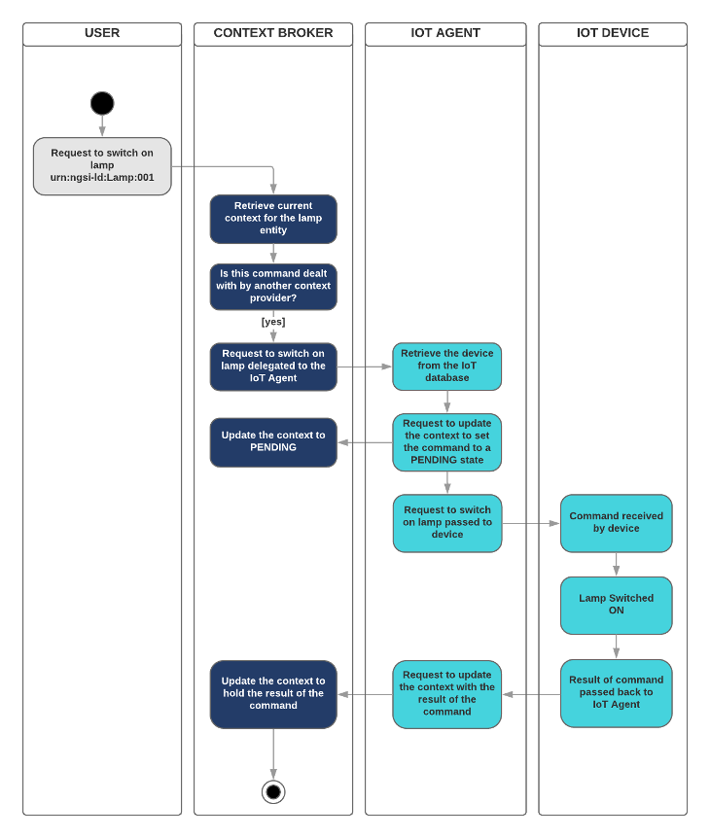
NGSI-LD Actuations
NGSI-LD actuation code is currently based on
the existing NGSI-v2 IoT Agent paradigm.
Uses registrations and request forwarding
Some details of the ETSI specification around
the final actuation interface still being discussed:
Federation?
Subscription based?
Full Actuation Interface?
The listening mechanism is internal to the
IoT Agent library and will be updated once the
proposed interface is finalized.

Slide 16
Command provisioning actuation registration (with Multi-tenancy):
“I am responsible for Attribute X”
IoT Agent Device Provisioning
Context Broker receives a Registration
curl -L -X POST 'http://localhost:4041/iot/devices' \
-H 'fiware-service: openiot' \
-H 'Content-Type: application/json' \
--data-raw '{
"devices": [
{
"device_id": "water001",
"protocol": "PDI-IoTA-UltraLight",
"transport": "HTTP",
"endpoint": "http://device:3001/iot/water001",
"entity_name": "urn:ngsi-ld:Device:water001",
"entity_type": "Device",
"commands": [
{
"name": "on",
"type": "command"
},
{
"name": "off",
"type": "command"
}
]
}
]
}'
curl -L -X POST 'http://localhost:1026/ngsi-ld/v1/csourceRegistrations' \
-H 'NGSILD-Tenant: openiot' \
-H 'Content-Type: application/ld+json' \
-d '{
"@context": "http://context.json-ld",
"endpoint": "http://iotagent.com",
"information": [
{
"entities": [
{
"id": "urn:ngsi-ld:Device:water001",
"type": "Device"
}
],
"properties": [
"on",
"off"
]
}
],
"type": "ContextSourceRegistration"
}
'

Slide 17
Actuation Request Forwarding (with Multi-tenancy)
Context Broker receives an Actuation
curl -L -X PATCH 'http://localhost:1026/ngsi-ld/v1/entities/urn:ngsi-ld:Device:water001/attrs/on' \
-H 'NGSILD-Tenant: openiot' -H 'Content-Type: application/json' \
-H 'Link: <http://context-provider:3000/data-models/ngsi-context.jsonld>; rel="http://www.w3.org/ns/json-ld#context"; type="application/ld+json"' \
--data-raw '{ "type": "Property", "value": " " }'
IoT Agent receives a forwarded Actuation
curl -L -X PATCH 'http://localhost:4041/ngsi-ld/v1/entities/urn:ngsi-ld:Device:water001/attrs/on' \
-H 'NGSILD-Tenant: openiot' -H 'Content-Type: application/json' \
-H 'Link: <http://context-provider:3000/data-models/ngsi-context.jsonld>; rel="http://www.w3.org/ns/json-ld#context"; type="application/ld+json"' \
--data-raw '{ "type": "Property", "value": " "}'
Multitenancy uses NGSILD-Tenant header if found, or the fiware-service header for backwards compatibility. And uses IOTA_FALLBACK_TENANT as a final backstop.

Slide 18
Combining NGSI-v2 and LD
function duplicateDevices(req, res) {
async function copyEntityData(device, index) {
await upsertDeviceEntityAsLD(device);
}
req.body.data.forEach(copyEntityData);
res.status(204).send();
}
Mapping NGSI-v2 to NGSI-LD is simple -
just re-use mapping code from within the
IoT Agent library
Use a one-shot subscription to duplicate
existing entities
Ongoing subscription for shadowing
device measures and creating linked data
entities with providedBy and observedAt
metadata attributes
Sample code:
https://github.com/FIWARE/tutorials.Step-by-Step/blob/master/
context-provider/controllers/ngsi-ld/device-convert.js
function shadowDeviceMeasures(req, res) {
const attrib = req.params.attrib;
async function copyAttributeData(device, index) {
await upsertDeviceEntityAsLD(device);
if (device[attrib]) {
await upsertLinkedAttributeDataAsLD(device,
'controlledAsset', attrib);
}
}
req.body.data.forEach(copyAttributeData);
res.status(204).send();
}

Slide 19
Summary
The IoT Agent Library now supports basic NGSI-LD operation
Already ported to most IoT Agents. Just upgrade to the latest version of the library
Some internal actuation mechanisms are still subject to change.
IoT Device provisioning has barely changed from NGSI-v2
Property, GeoProperty and Relationship are reserved keywords
Use native JSON types and GeoJSON types whilst provisioning
Use metadata and avoid meaningless type attributes
More info: https://iotagent-node-lib.readthedocs.io/
JSON-LD @context makes your data interoperable.
Ensure your JSON-LD @context is maintained and publicly available
JSON-LD specification: https://json-ld.org/
More info: https://github.com/FIWARE/tutorials.Understanding-At-Context
Fallback to using subscriptions and mapping when combining NGSI-v2 Devices with an NGSI-LD Context Broker

